Slide 1
What drives parent’s decisions when choosing a name?
Alla Zbirun
Gizem Yali-Pepper
Hernan Hernandez
Michael Boccio
Raymond Fendi

Slide 2
Motivations
Curiosity about cultural differences across the United States.
It is known that names change over locations and times. What drives these changes?
Are there external factors that influence parents' decision making?
Quality and ease of available data.
Choosing a name is a defining moment for both parents and children.

Slide 3
Questions
What are the most popular names in each state?
Are there differences in name choices in blue states and red states?
Is there a relationship between a child’s name and popular culture?

Slide 4
Executive Summary
In some cases, there is a relationship between popular culture and the popularity trend of a name. When a unique name appeared in popular culture there was a resulting rise in parents choosing that name for their child.
We found minimal difference between the naming choices of red and blue states when considering the most popular names. The most popular names tend to be ubiquitous across the United States.

Slide 5
Hypothesis
There will be no difference between the naming choices of red and blue states.
The frequency of a baby name during the height of a celebrity's popularity will be equal to the frequency of a baby name before/after the celebrity's popularity.

Slide 6
Data Cleanup & Exploration
Sources
Kaggle – using social security database
Big Query API
CSV files from the Social Security Administration
Wikipedia – used for gathering celebrity names across pop culture
Data Cleanup
Importing data from 51 CSV files and concatenating data
Replacing names that did not appear in a specific state (NaN) with a count of 0
???

Slide 7
Data Cleanup & Exploration
Interesting findings during Data Exploration
???
???

Slide 8
Data Analysis
Steps taken to analyze the data
???
???

Slide 9
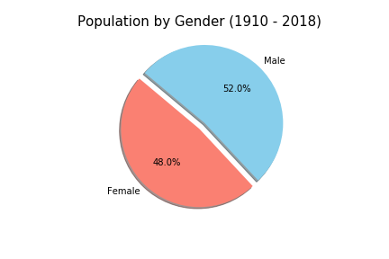
Data Analysis

Slide 10
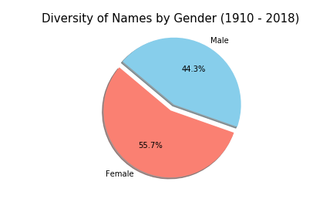
Data Analysis

Slide 11
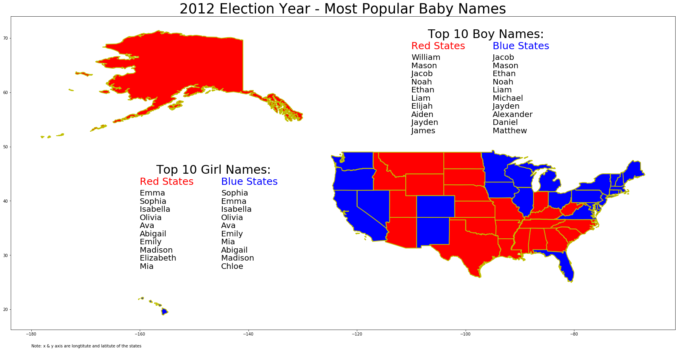
Data Analysis

Slide 12
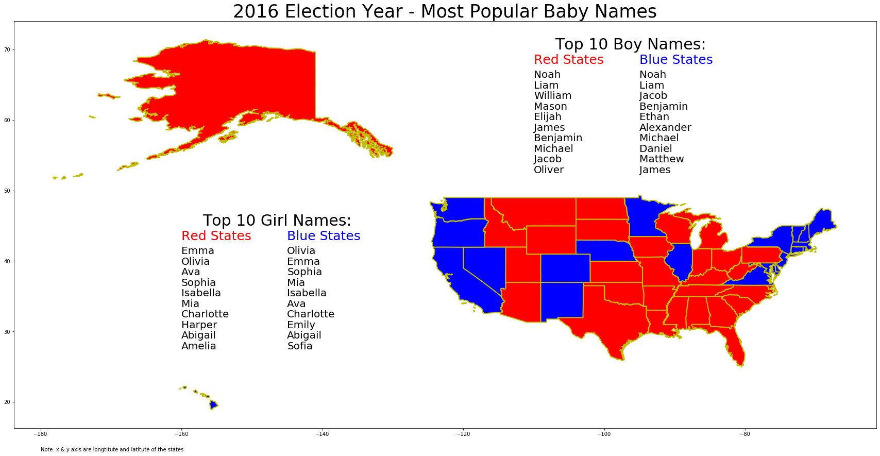
Data Analysis

Slide 13
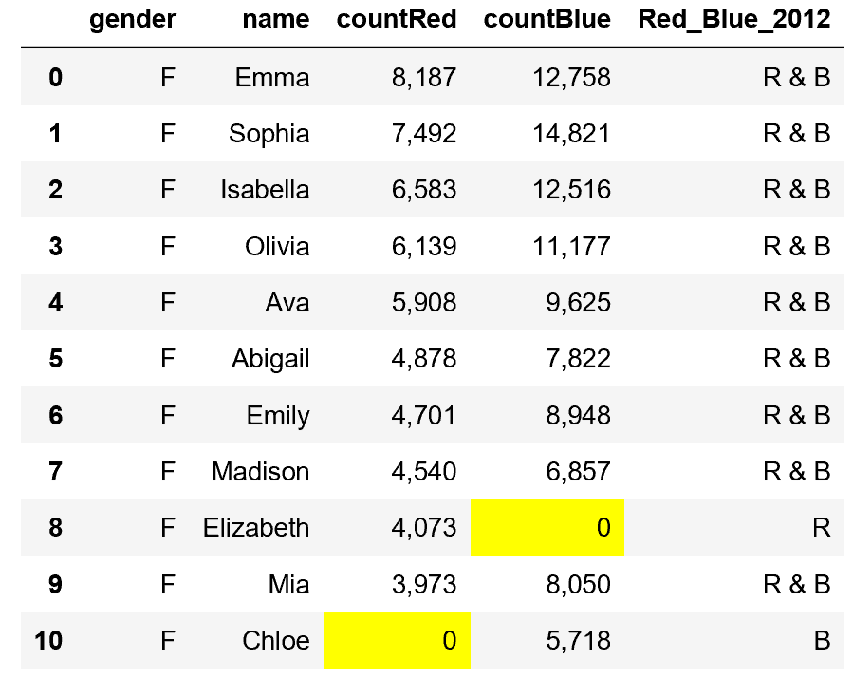
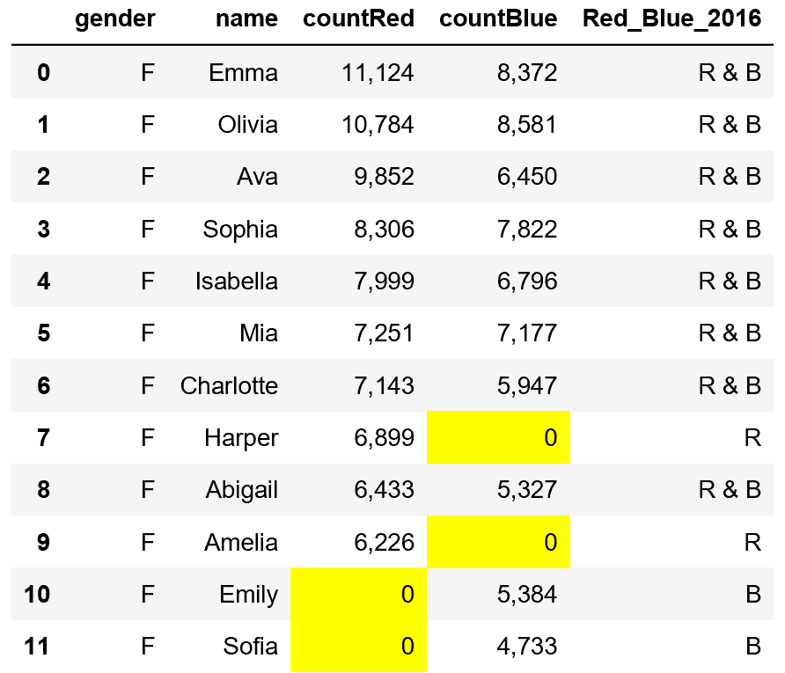
Top Girl Names

Slide 14
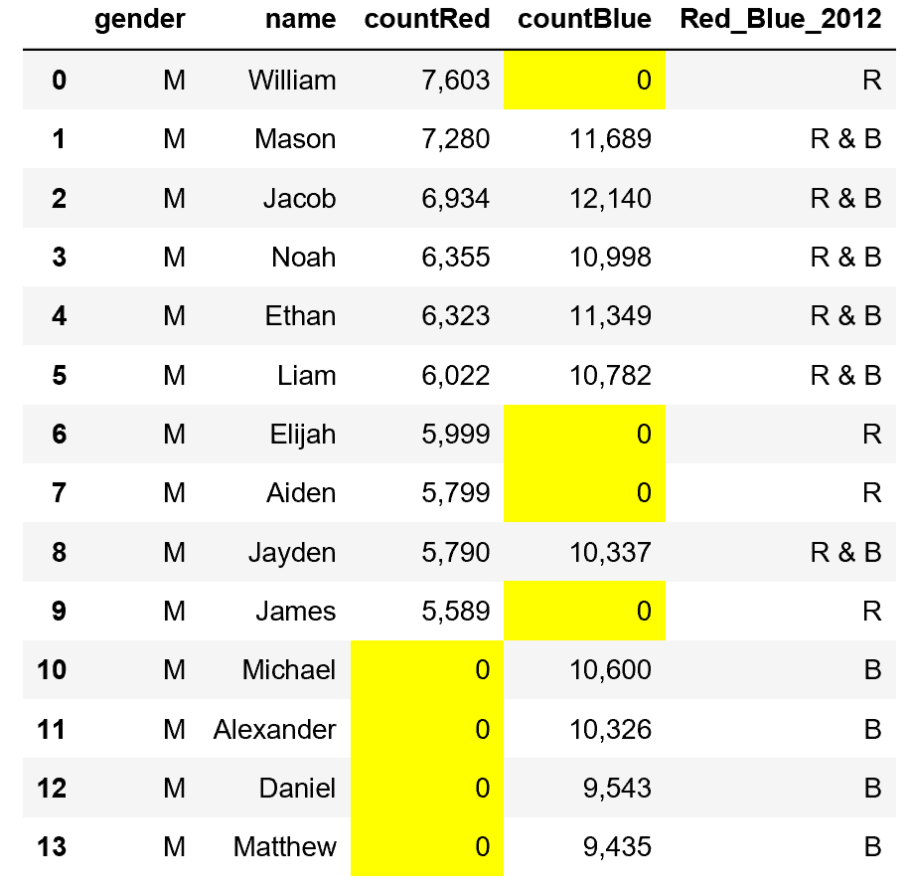
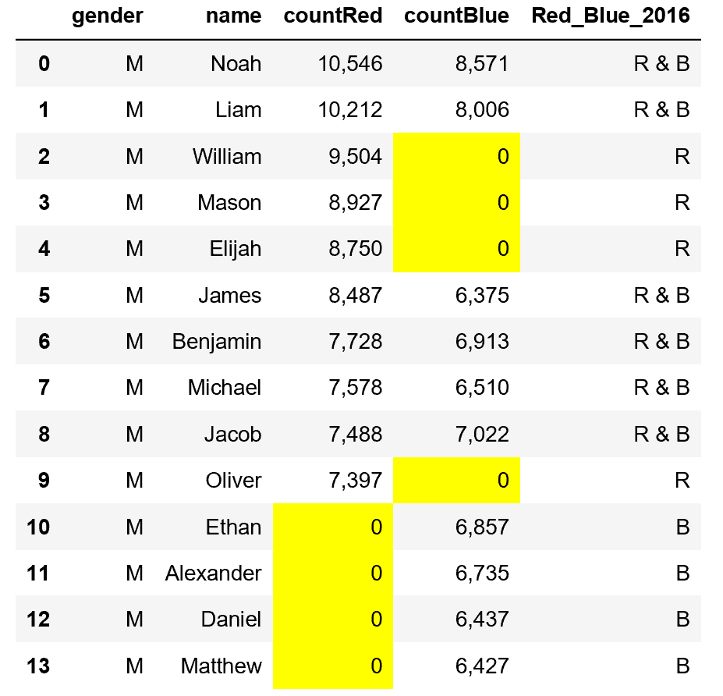
Top Boy Names

Slide 15
Data Analysis

Slide 16
Data Analysis

Slide 17
Data Analysis

Slide 18
Data Analysis

Slide 19
Data Analysis

Slide 20
Discussion
The surprising ubiquity of the most popular names
The resiliency of popular names across time
Less popular names can see a spike due to popular culture
Timing of popularity spikes vs a celebrity's popularity
Notoriety can cause a name to decrease in popularity

Slide 21
Issues & Limitations
Dataset is 52% male but there is a higher diversity of girl's names
Difficult to analyze some names due to unique spelling
Popularity is an abstract measure – tough to judge using data only
Popular names will have popularity regardless of celebrities in pop culture
A popular name will also tend to have more celebrities with the name
Technical limitations occurred when attempting to produce a map with names tied to specific states

Slide 22
Don’t forget to do the write up

